Slide 1
What is Data Analytics?
Week 1

Slide 2
Types of Data
Structured
Unstructured
Natural language
Machine-generated
Graph-based
Audio, video, and images
Streaming

Slide 3
Unstructured Data
Majority of business information are unstructured form, primiparity text.
Unstructured data occupies 90% of the data by volumes.
Structured Data High degree of organization, such as relational database | Unstructured Data Information that is difficult to organize by traditional tools
 | The patient came for complaining chest. He smokes two pack a day.
Column | value
Patient | Joe Brown
Date of Birth | 02/13/1972
Date Admitted | 02/05/2014

Slide 4

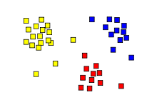
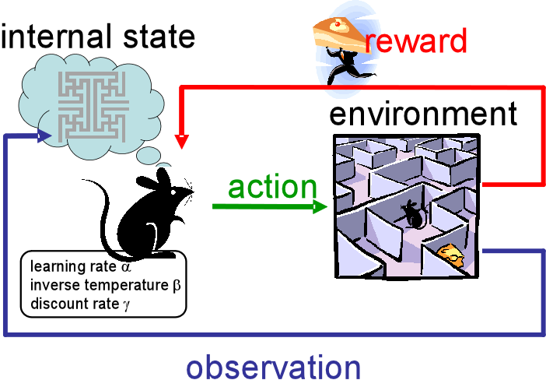
Algorithm selection
Supervised
Task driven (regression/clustering)
Can measure accuracy directly
Unsupervised Learning
Data driven (clustering)
Looking for patterns
No prior knowledge from data
Semi-supervised learning
A mix of supervised and unsupervised learning
Reinforcement Learning
Algorithm learns to react to the environment
class A
class A
Classification
Regression
Clustering

Slide 5
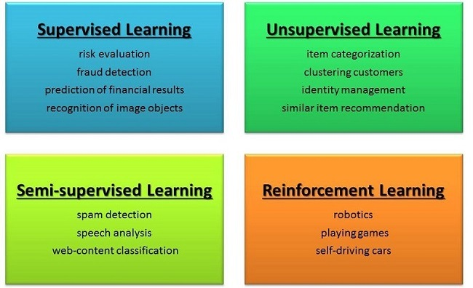
Algorithm selection

Slide 6
Algorithm selection (cont)
Supervised
Regression
Classification
Linear, nonlinear
K-nearest neighbor
SVM
Random forest
Decision tree
Random Forrest
Logistic regression
Naïve Bayes
Unsupervised
Clustering
Anomaly Detection
Shit-Mean
Mixture Model
Hierarchical clustering
Local outlier factor
DBSCAN
OPTICS algorithm

Slide 7
Algorithm selection (cont.)
Deep learning
Convolutional
Generative adversarial
Recurrent
Deep belief
Deep Boltzmann
LSTM
Bi-directional
Autoencoders
Representation learning
Reinforcement leaning
Monte Carlo methods
Temporal deference methods
Q-learning
Dynamic programming
Continuous space

Slide 8
Machine learning
Machine learning is a field of computer science that gives computers the ability to learn without being explicitly programmed
Labeled Data
Machine Learning algorithm
Training
Prediction
Labeled Data
Learned model
Prediction

Slide 9
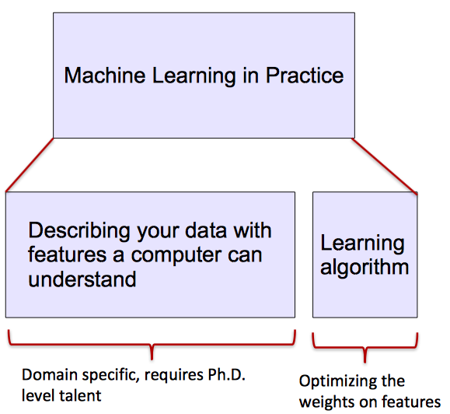
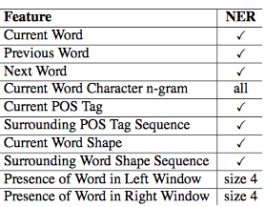
Deep leaning vs. Machine Learning
Most machine learning methods work well because of human-designed representations and input features
ML becomes just optimizing weights to best make a final prediction

Slide 10
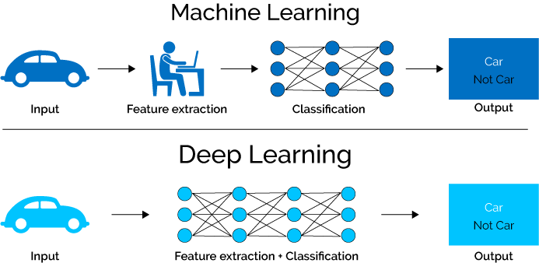
Deep leaning vs. Machine Learning
Deep learning algorithms attempt to learn (multiple levels of) representation by using a hierarchy of multiple layers.
If you provide the system tons of information, it begins to understand it and respond in useful ways.

Slide 11
In the rest of this course – Part 1 Natural Language Processing

Slide 12
Unstructured Data
Text analytics uses algorithms for turning unstructured data in to the structured data using natural language processing, statistical and machine learning methods
After generating structured data, analytic techniques can be applied.
Most significant part of text mining is how to convert text into structure data

Slide 13
Text analytic
Collect Data
Text Filtering
Transformation
Text Parsing
Text Mining
Documents
Web pages
Comments
Extract words
Parts of Speech
Stemming
Word filtering
Filter irrelevant
Filter Stop lists
Convert the text to matrix or vector
Topic extraction
Sentiment Analysis
Document similarity

Slide 14
Text analytic
Pattern Discovery (Unsupervised learning):
Clustering, Segmentation
Associations
Prediction (Supervised learning):
The target variable is defined and predictive model is developed

Slide 15
Text mining application
Information retrieval:
Finding documents with relevant contents
Research
Document categorization
Documents Clustering
Extracting themes
Anomaly detection
Fraud activity

Slide 16
Text mining & Deep learning
Natural language processing (NLP) is a subfield of computer science, artificial intelligence and linguistics. It studies the problems of automated generation and understanding of natural human languages.
Statistical natural language processing uses stochastic, probabilistic and statistical methods to resolve some of the difficulties : e.g. text segmentation, word sense disambiguation.

Slide 17
Text analytic
Text pre-processing :
Text cleaning:
Remove the tags from web documents
Exclude the irrelevant words such as Ushhhhhhh
Correct misspelled words
Tokenizing:
Remove punctuations, upper/lower case, normalization
Part of speech:
Noun, verb, adjective,…
Filtering stop words.
Other NLP features techniques.

Slide 18
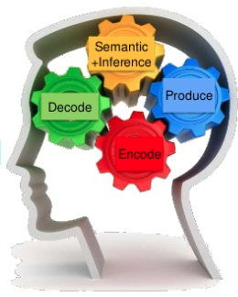
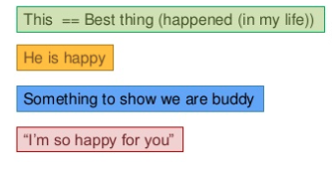
Text Mining
Text Vectorization
Hot vector
Bag of words
TFIDF
Word2Vec
Text Mining:
Sentiment Analysis
Document Similarity
Topic Modeling/Feature Selection

Slide 19
In the rest of this course – Part 2 Neural Network and Its Applications

Slide 20
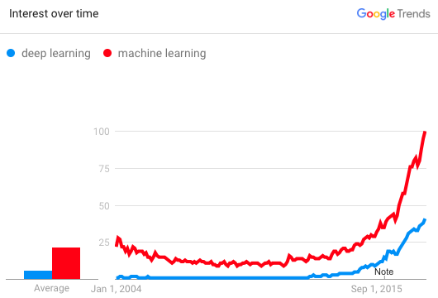
Neural Network
Manually designed features are often over-specified, incomplete and take a long time to design and validate
Deep learning provides a very flexible, (almost?) universal, learnable framework for representing world, visual and linguistic information.
Effective end-to-end joint system learning
Utilize large amounts of training data
In ~2010 DL started outperforming
other ML techniques
first in speech and vision, then NLP

Slide 21
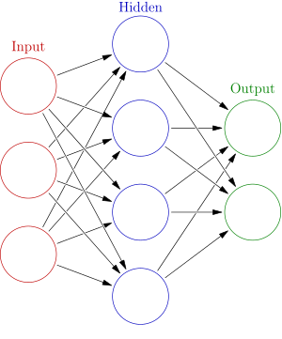


Shallow Neural Network
One layer neural network
4 + 2 = 6 neurons (not counting inputs)
[3 x 4] + [4 x 2] = 20 weights
4 + 2 = 6 biases
26 learnable parameters
$$h= σ(W_{1}x+b_{1})$$
$$y=σ(W_{2}h+b_{2})$$

Slide 22
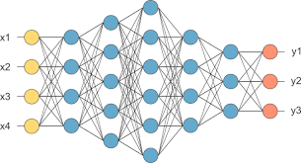
Deep Learning
Multi-layer neural network

Slide 23
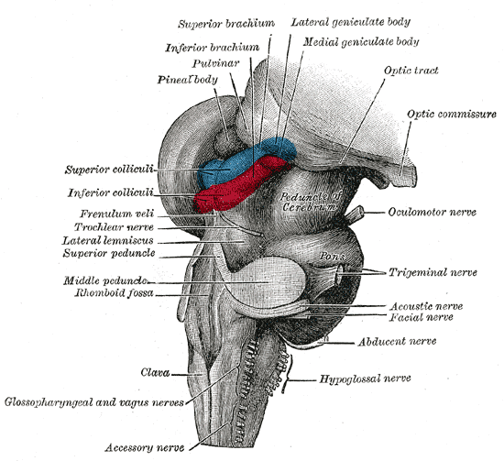
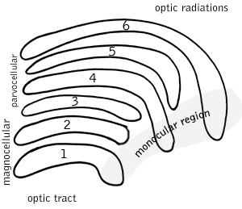
Deep learning vs. Human brain
what exactly is deep learning ?
‘Deep Learning’ means using a neural network
with several layers of nodes between input and output
Your brain works same way-However
we have been trained for million of years.
the series of layers between input &
output do feature identification and processing
in a series of stages, just as our brains seem to.

Slide 24
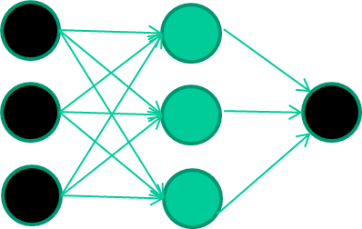
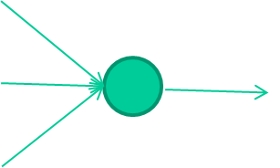
Deep leaning
Training the neural network
Fields class
1.4 2.7 1.9 0
3.8 3.4 3.2 0
6.4 2.8 1.7 1
4.1 0.1 0.2 0
etc …
-0.06
W1
-2.5
W2
f(x)
x = -0.06×1.4 - 2.5×2.7 + 1.4×1.9
1.4
W3

Slide 25
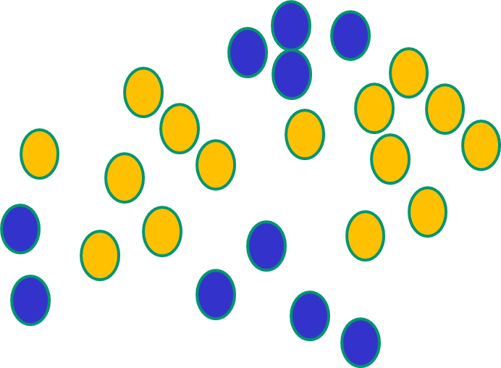
Neural Network property
NNs use nonlinear f(x) so they can draw complex boundaries.

Slide 26
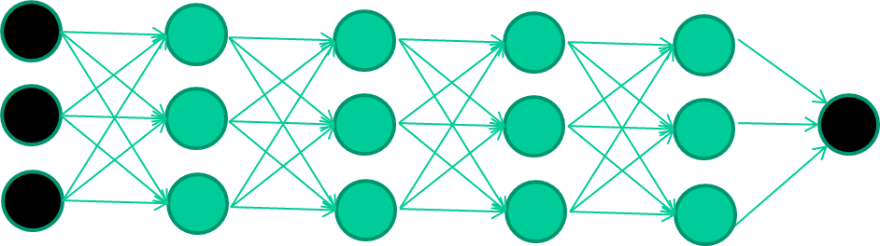
Train multi-layer NNs…
The problem is broken into a discrete series of instructions
Instructions are executed sequentially

Slide 27
Deep leaning
Flow chart:
Start with random numbers.
Feed it through to get output
Compare with the target and compute the error
Adjust weights based on the error
Algorithms for weight adjustment are designed to make changes that will reduce the error
Repeat the process till error pass the threshold value

Slide 28
AI/ Deep Learning Contents
Main components/hyper-parameters:
Number of the layers and nodes
Activation function
Optimizers, cost functions
Regularization methods
Tuning

Slide 29
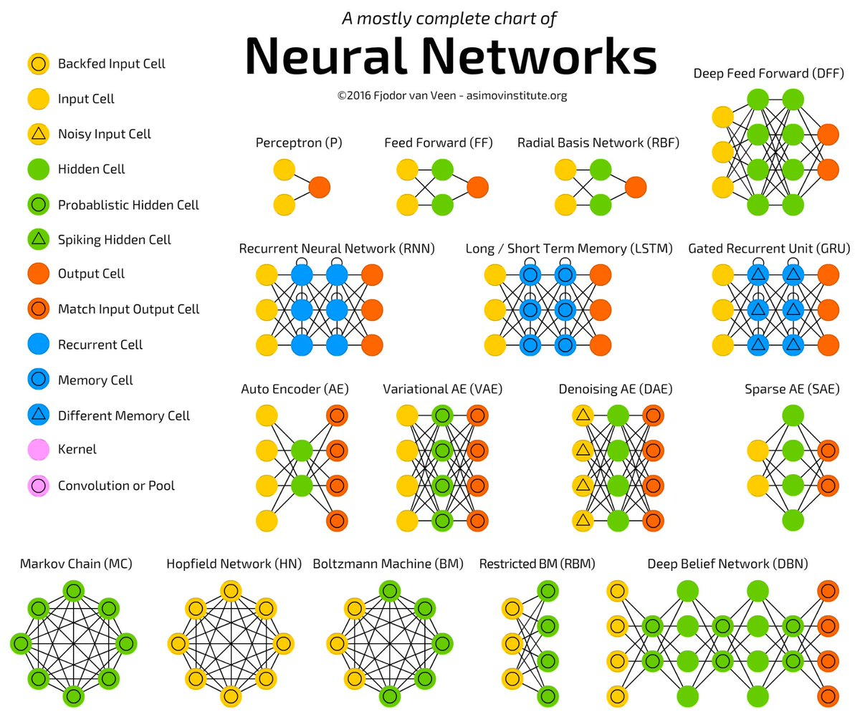

Slide 30
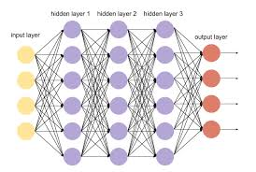
Fully connected Multi-layer Neural Network

Slide 31
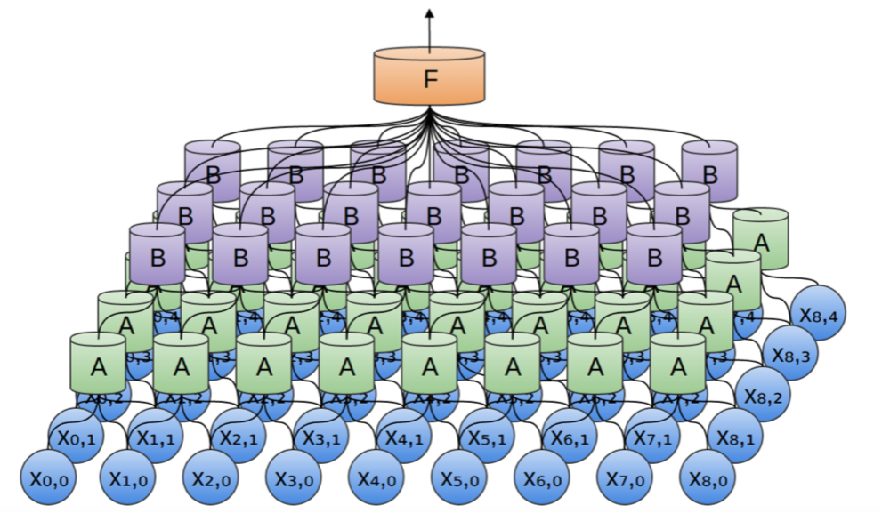
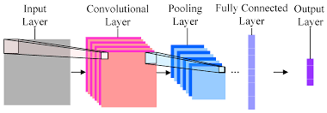
Convolutional Neural Notework

Slide 32
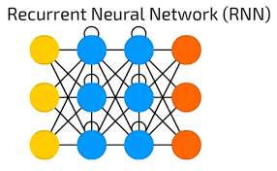
Convolutional Neural Network

Slide 33
DNN frameworks
Caffe
CNTK
Pytorch
Tensorflow
Keras

Slide 34
Python for Data Science
Python crash course
Data analytics libraries
Numpy
Scipy
Pandas
Data visualization libraries
Seaborn
Matplotlib
PyPlot
Cufflinks
Machine learning libraries
Scikit-learn
H2O
Tensorflow
PyTorch
Objects and classes
Data elements
Functions & methods
Applications and packages
Keras

Slide 35
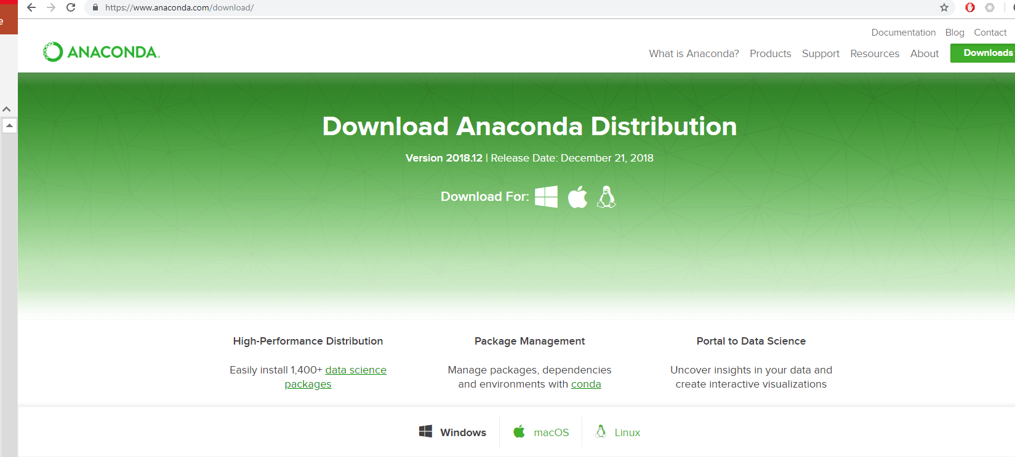
For Next Week

